Slide 1
VEHICLE DETECTION SYSTEM
By: - Sanskar Wagavkar

Slide 2
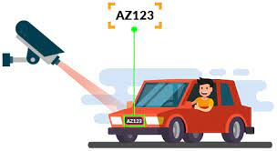
INTRODUCTION
Vehicle detection systems have become an essential part of modern-day traffic management, especially in crowded areas such as college campuses.
A vehicle detection system can help monitor the movement of vehicles entering and exiting a campus, which can help improve security, traffic flow, and overall management of the campus

Slide 3
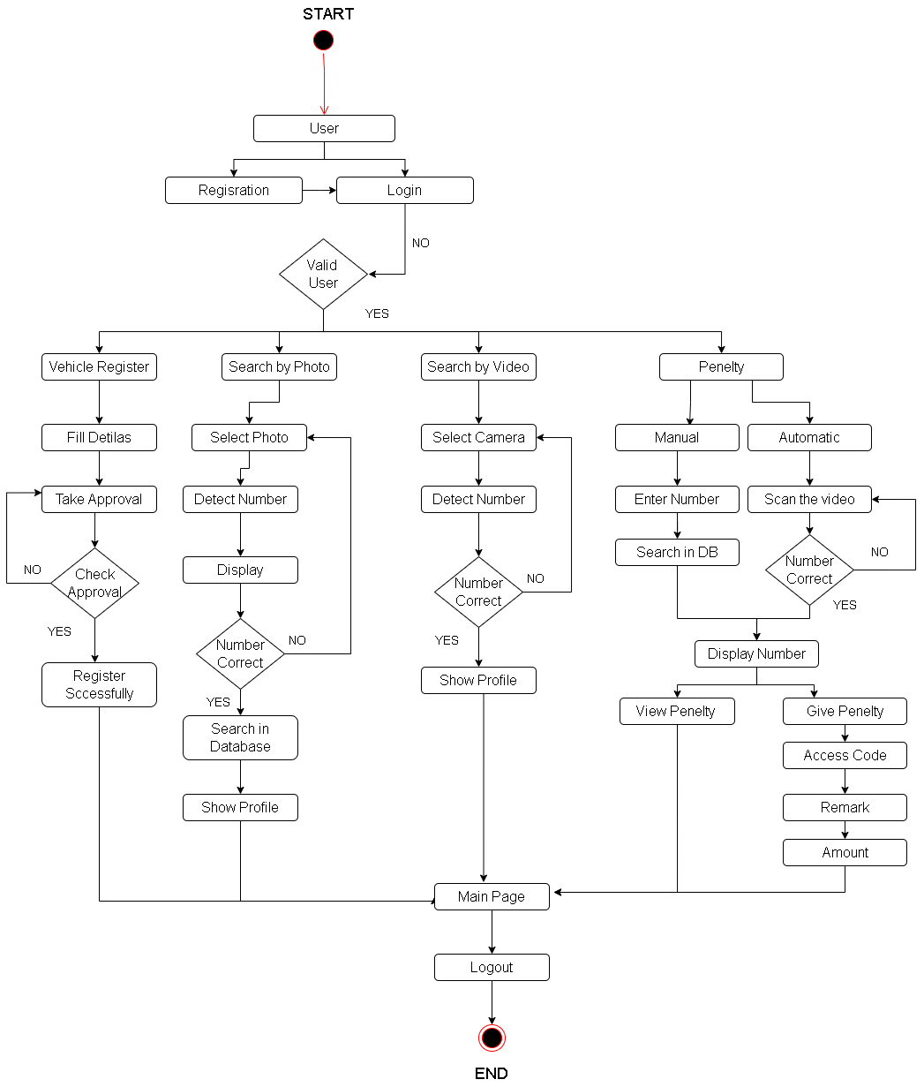
UML DIAGRAMS
Activity Diagram

Slide 4
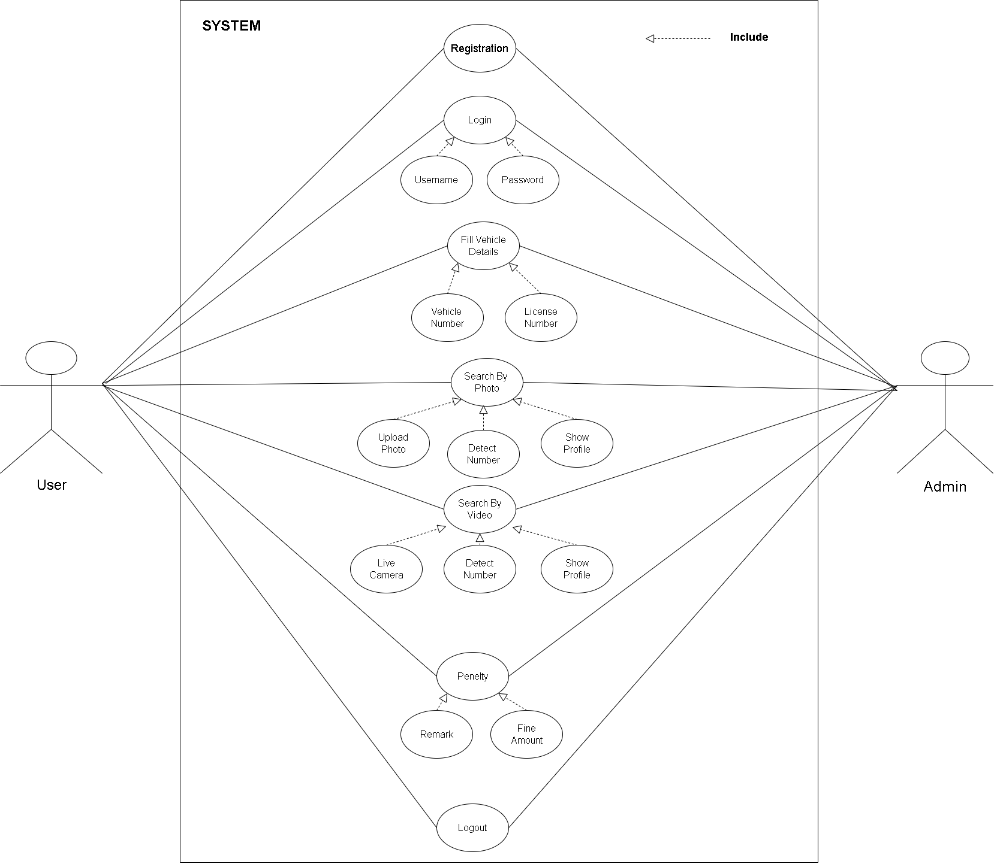
UML DIAGRAMS
Use Case Diagrams

Slide 5
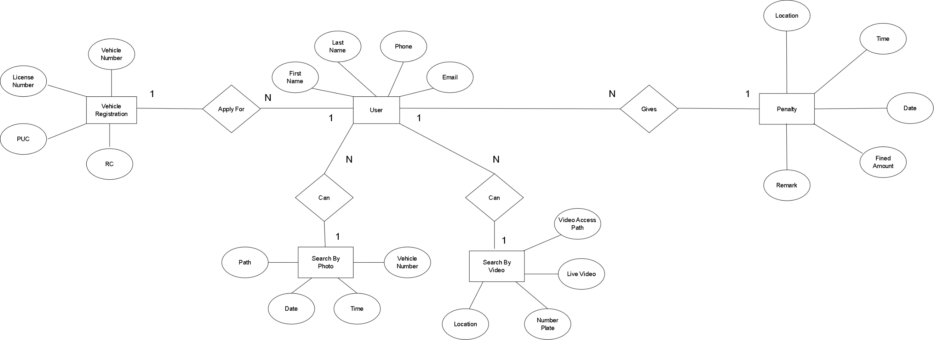
UML DIAGRAMS
E-R Diagrams

Slide 6
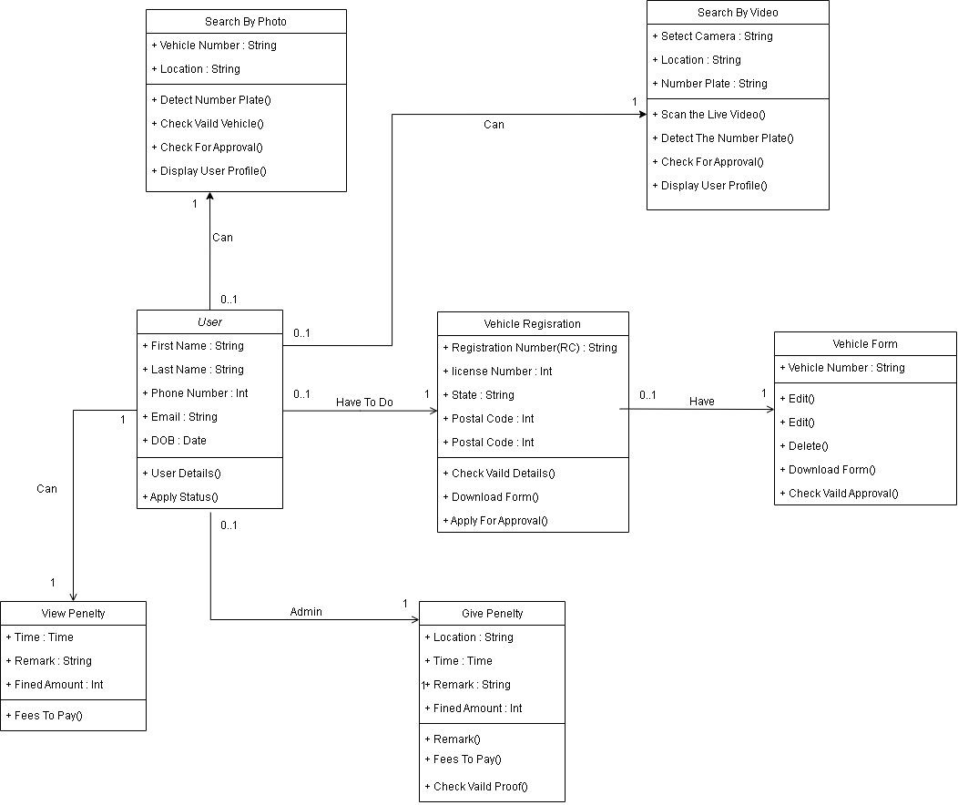
UML DIAGRAMS
CLASS DIAGRAMS

Slide 7
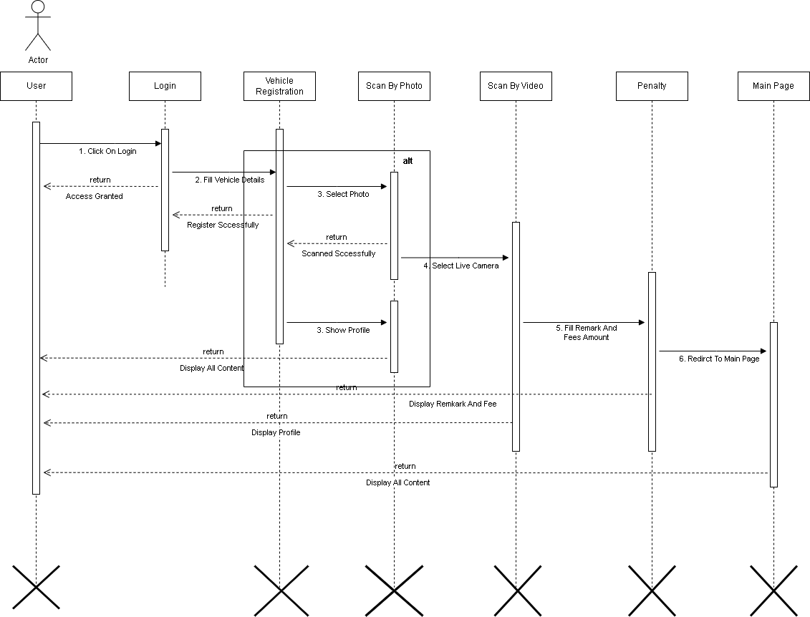
UML DIAGRAMS
SEQUENCE DIAGRAM

Slide 8
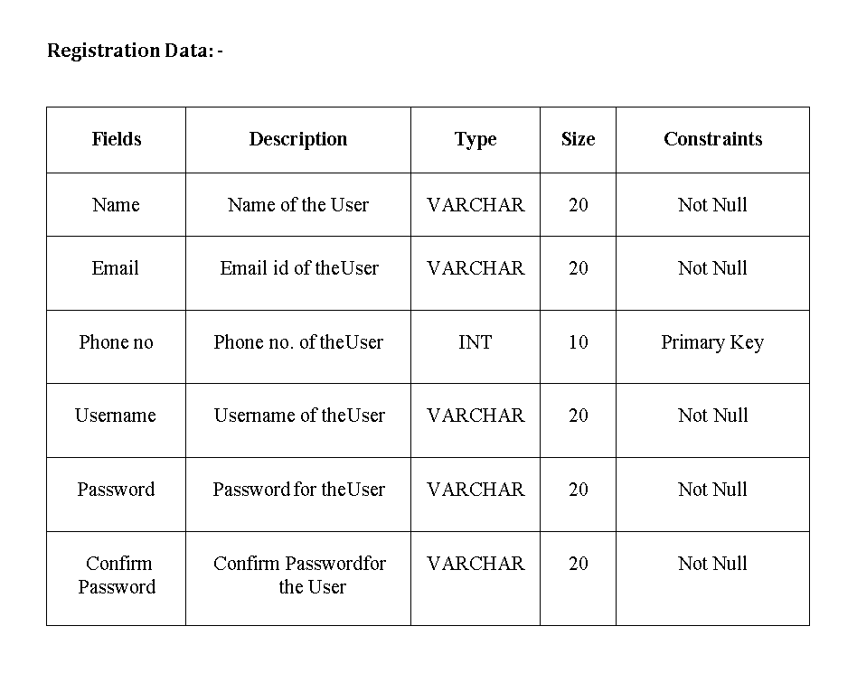
NORMALIZED DATABASE TABLE

Slide 9
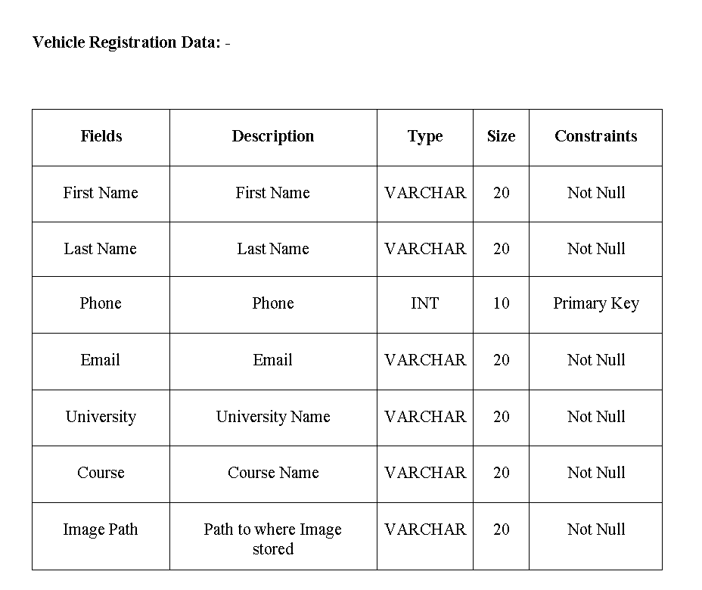
NORMALIZED DATABASE TABLE

Slide 10
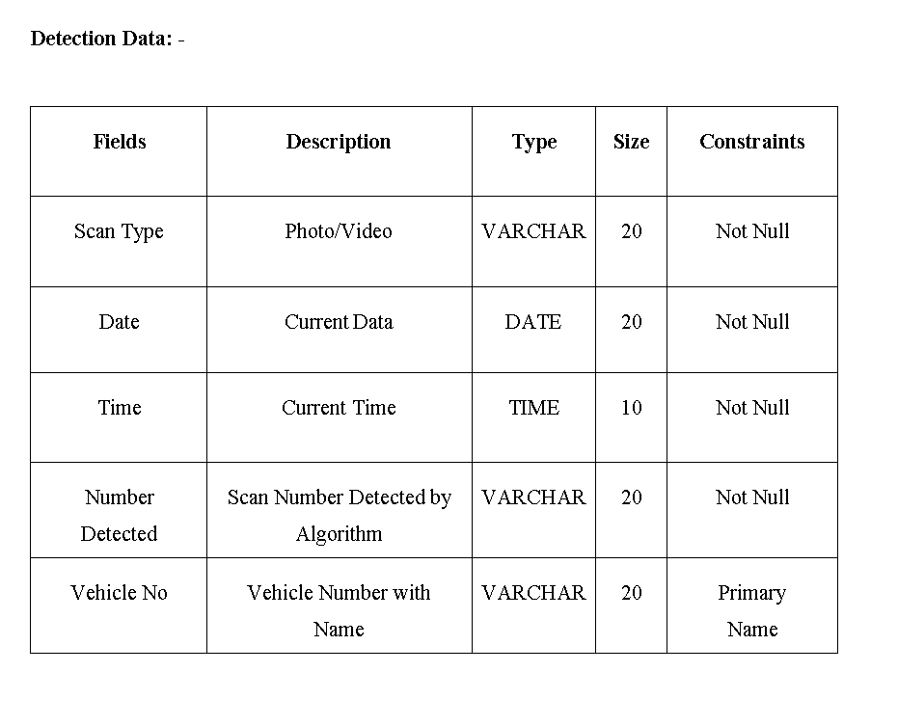
NORMALIZED DATABASE TABLE

Slide 11
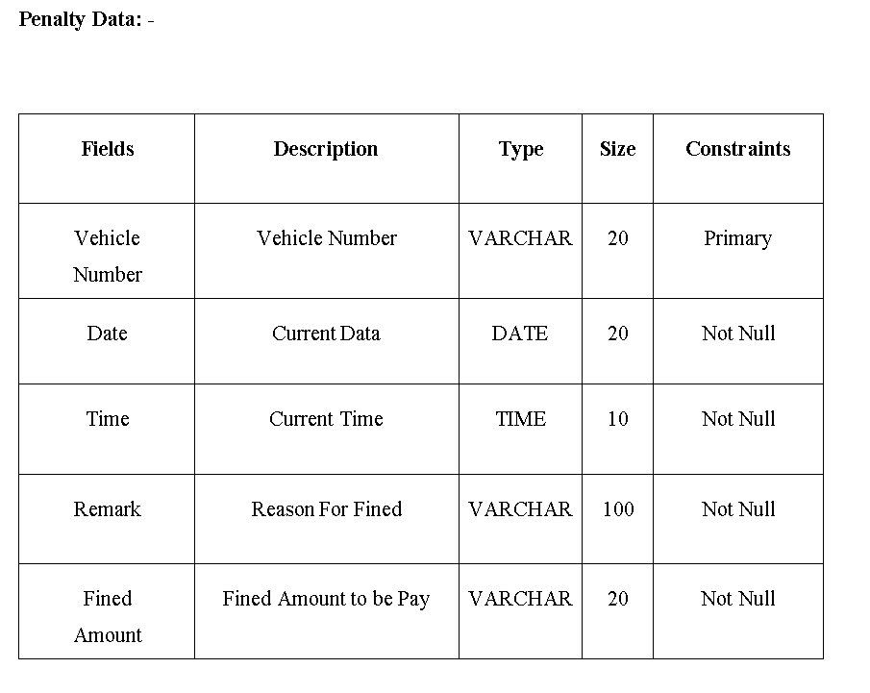
NORMALIZED DATABASE TABLE

Slide 12
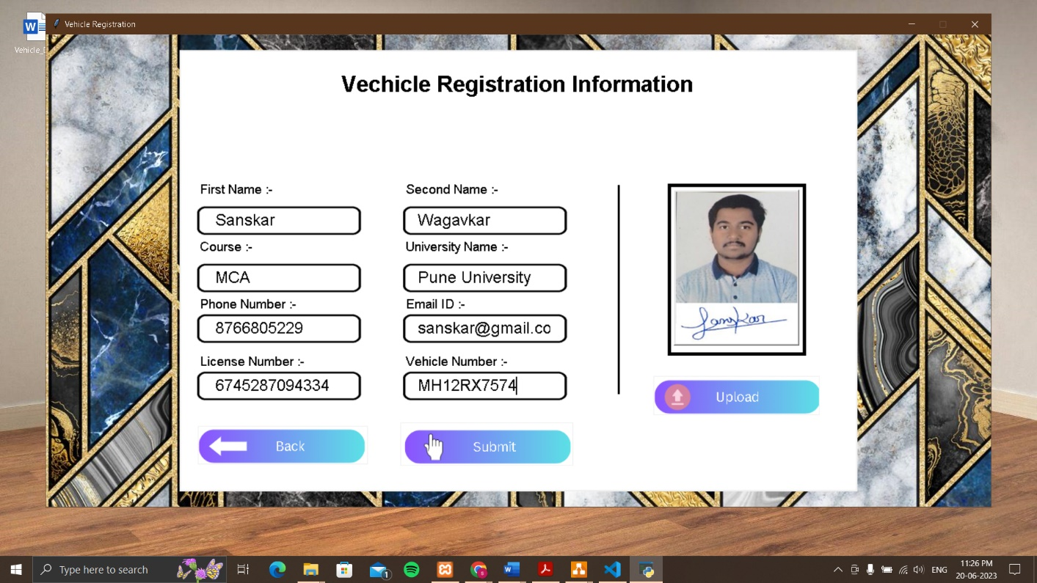
INPUT SCREEN

Slide 13
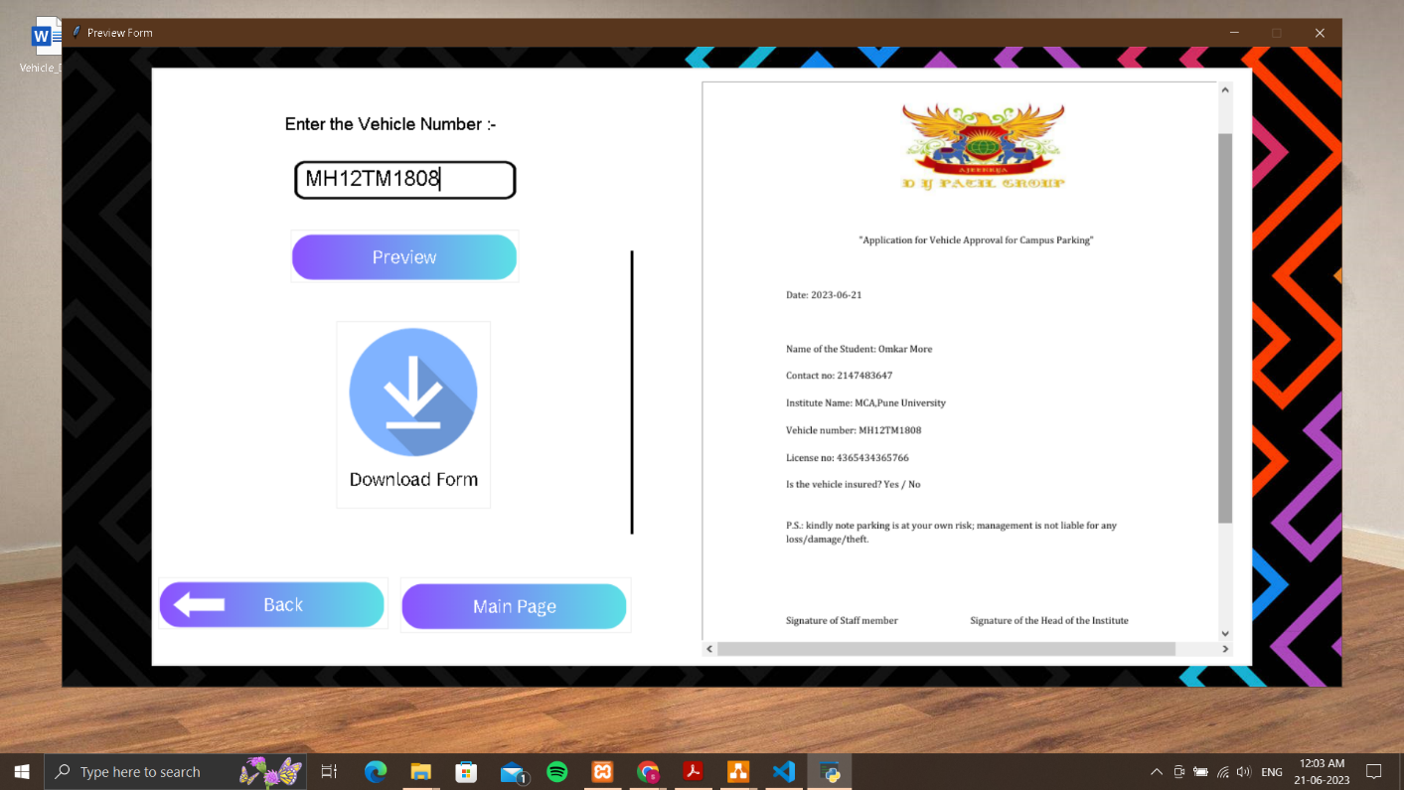
INPUT SCREEN

Slide 14
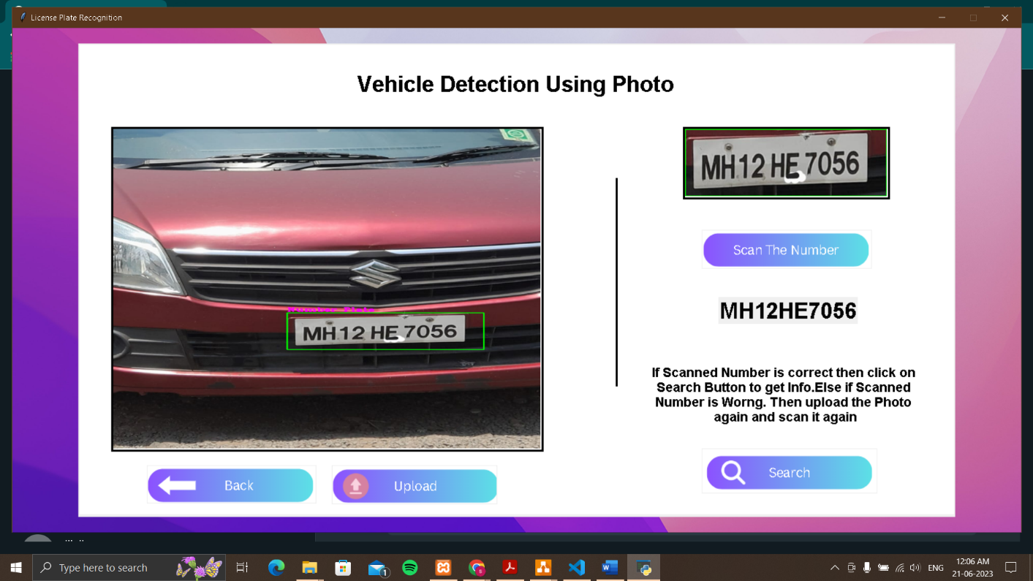
INPUT SCREEN

Slide 15
THANK YOU ☺

